Slide 1
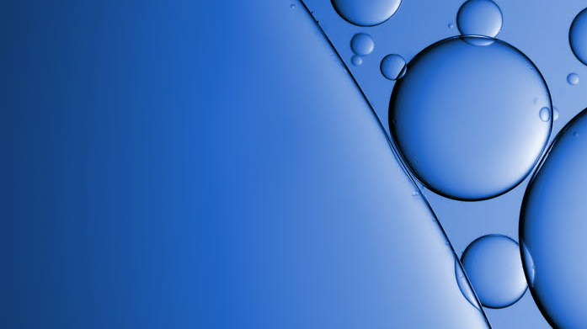

AAK Personal Care
AAK Personal Care
Making Better HappenTM
Making Better Happen™
Part 1 : Shea esters
And how to improve the sensory experience of your formulations while providing real benefits.
Charlotte Leproust – Customer Innovation Manager
Ben Sales – International Sales Manager
June 4, 2025

Slide 2

Agenda
1
Discover how
Lipex® SheaSolveTM
enables the creation of high-performance formulations in different categories.
2
Achieve natural, lightweight and silicon-like textures in skin care and hair care with Lipex® SheaLuxe TRTM

Slide 3
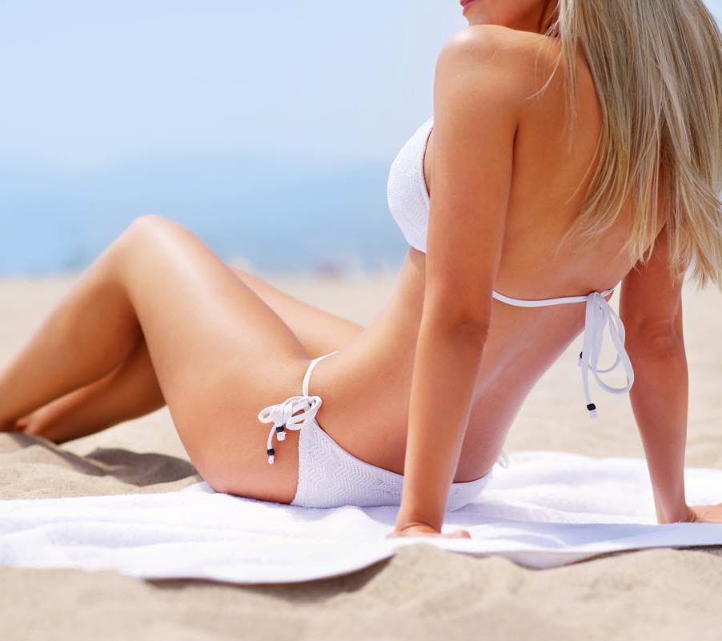
Discover how
Lipex® SheaSolveTM enables the creation of high-performance formulations in different categories.

Slide 4
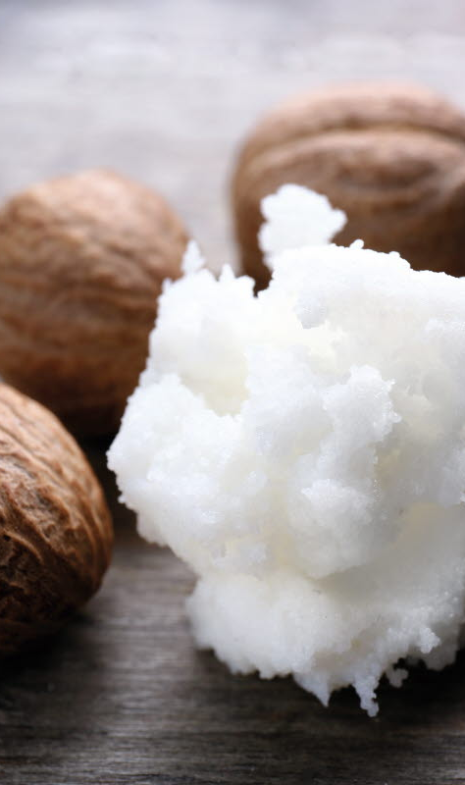









LIPEX® SheaSolve™
INCI: Shea Butter Ethyl Esters
Ester from natural Ethanol & Shea Butter
Light emollient
Multifunctional ingredient with benefits in multiple categories: Sun Care, Make-up, Hair Care, Skin Care.
Functionality
Mass Balance Kolo Nafaso
Sustainably – sourced shea
Empowering women shea collectors.
Supporting the future of shea
Eco-designed, 100% Renewable sources.
Sustainability
Legal compliance

Slide 5

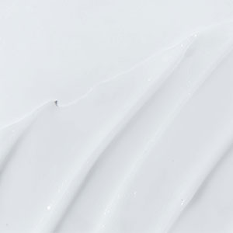
The benefits of LIPEX® SheaSolve™
Great wetting properties (pigments)
Light & flowable dispersion
Lighter textures
More manageable dispersion in production
Better pay-off
Inorganic UV filters:
Light & flowable dispersion
Lighter textures
Reduce ghosting effect
SPF Booster
Organic UV filters:
- Good UV filter dispersion
MAKE-UP
SUNCARE
LIPEX® SheaSolve
Cleansing/ Make-up remover properties
Lightweight emollient
Improve combing on wet and dry hair, compared to dimethicone
SKINCARE
HAIRCARE

Slide 6

LIPEX® SheaSolve™ in Suncare

Slide 7
LIPEX® SheaSolve™ in suncare with inorganic UV filters
Provides SPF boosting & ensure the SPF value that you formulate for
Based on the amount and the type of UV filter (20% zinc oxide with triethoxycaprylyl silane coating) the expected SPF reading for all dispersions was 28.
Only Lipex SheaSolve delivers towards that expectation, which provides assurance for formulators that they can achieve the SPF value they need for their cosmetic formulae.
Lipex SheaSolve is a more cost-effective emollient compared to the alternatives since higher amounts of UV filters would be needed with the other emollients to achieve the same SPF value.
Expected SPF reading = 28
+22%
+54%
The story of Sun and Shea
Shea is known for its inherent UV absorbing properties**, therefore a shea derivative such as Lipex SheaSolve is a great fit for formulations carrying sun protection claims
Lipex SheaSolve
Naturalness*
100%
based on shea
0%
synthetic
70%
based on palm
* Share of C-atoms from renewable sources
** Source: Sarruf Fernanda, Sauce Rafel, Candido Thalita, Oliviera Camila, Rosado Catarina, Velasco Maria, Baby André, Journal of Cosmetic Dermatology, May 2020, Butyrospermum parkii butter increased the photostability and in vivo SPF of a molded sunscreen system.
SPF study conducted by Helioscience using an adapted in vitro method for mineral sunscreens with good correlation with in vivo SPF method.

Slide 8
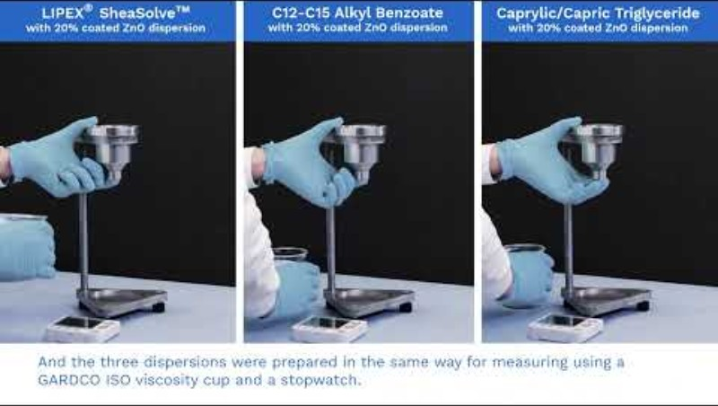

LIPEX® SheaSolve™ in suncare with inorganic UV filters
Achieve low viscosity and high flowability mineral UV filter dispersions
This video says it all – watch for yourself !

Slide 9
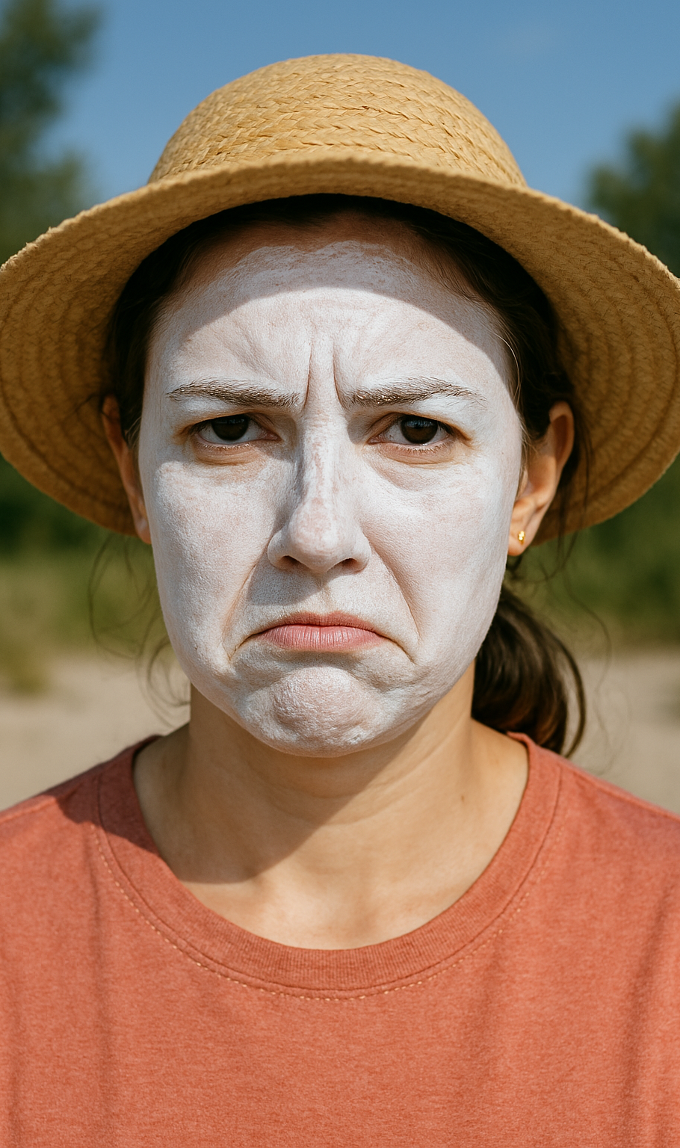
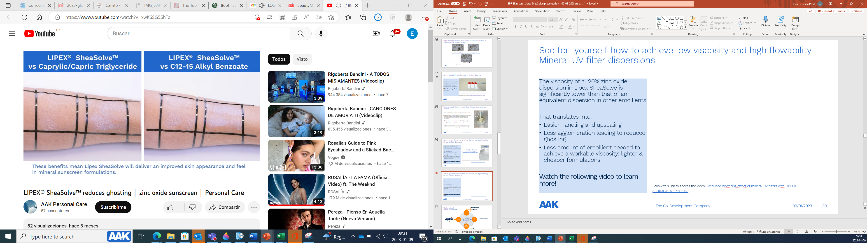
LIPEX® SheaSolve™ in suncare with inorganic UV filters
Reduced ghosting of your formulations
We have previously seen that a 20% zinc oxide dispersion in LIPEX® SheaSolve™
delivers:
Improved wetting
Lower agglomeration
Lower viscosity
Caprylic/capric triglyceride
Lipex SheaSolve
C12-15 Alkyl Benzoate
This translates into reduced ghosting when applied to the skin.
Watch the following video to learn more!
Reduced whitening effect of mineral UV filters with LIPEX® SheaSolveTM – Youtube
18/06/2025
9

Slide 10
LIPEX® SheaSolve™ in suncare with organic UV filters
Provides solubilization of organic filters
Solubility of Uvinul T150
(Ethylhexyl Triazone)
Solubility of Tinosorb S
(Bis-Ethylhexyloxyphenol Methoxyphenyl Triazine)
Solubility of Parsol 1789
(Butyl Methoxydibenzoylmethane)
Lipex SheaSolve
Lipex SheaSolve
Lipex SheaSolve
Solubility study using a spectrophotometric method. Study conducted by Q&Q Labs.
Uvinul T150 (Ethylhexyl Triazone), Tinosorb S (Bis-Ethylhexyloxyphenol Methoxyphenyl Triazine), Parsol 1789 (Butyl Methoxydibenzoylmethane)

Slide 11

LIPEX® SheaSolve™ in suncare
Photostability et photoxicity datas
Photostability:
Based on internal testing made by AAK:
Where samples were exposed to UV light (max 4.5kW/m2) for 8 hours at RT, we can conclude that LIPEX® SheaSolve™ does not break down under UV exposure.
There was no oxidation detected after the irradiation.
Phototoxicity :
Based on external testing carried out by ProDerm Institute for applied dermatological research:
The in-vivo study carried out with 28 panelists showed no evidence of erythema on skin.
We can conclude that LIPEX® SheaSolve™ does not provide any phototoxic reaction.
The Co-Development Company

Slide 12
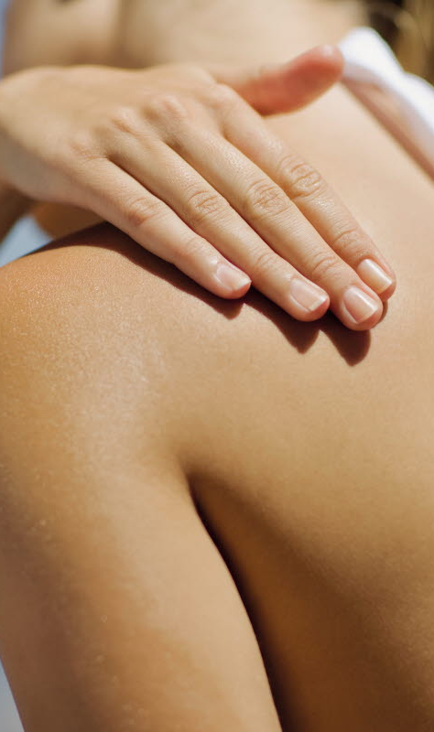
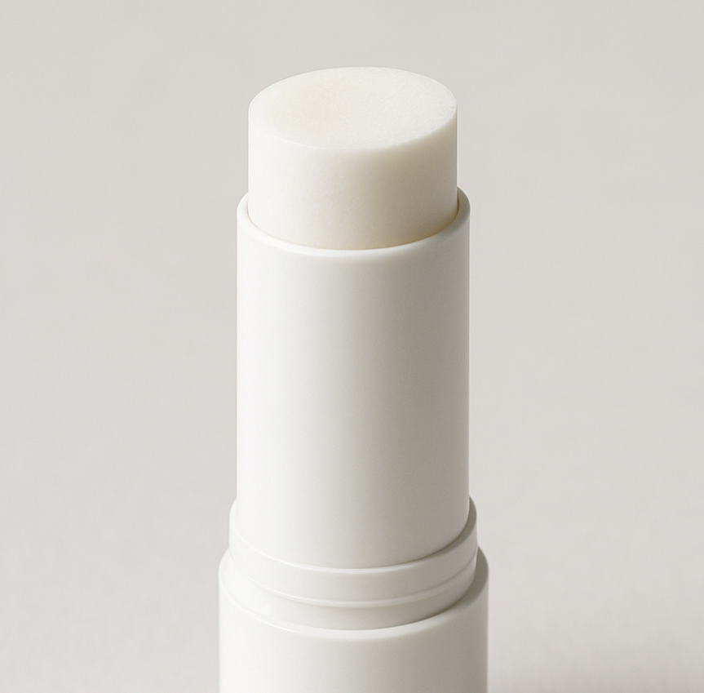
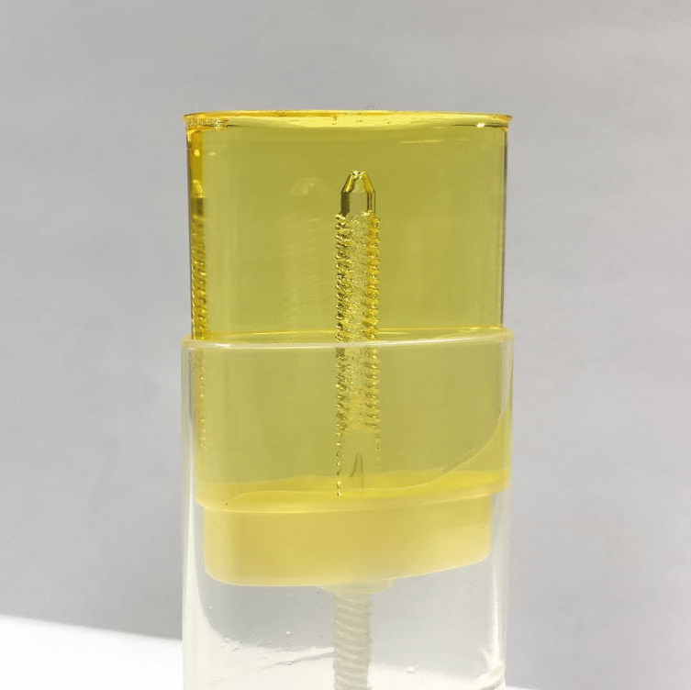
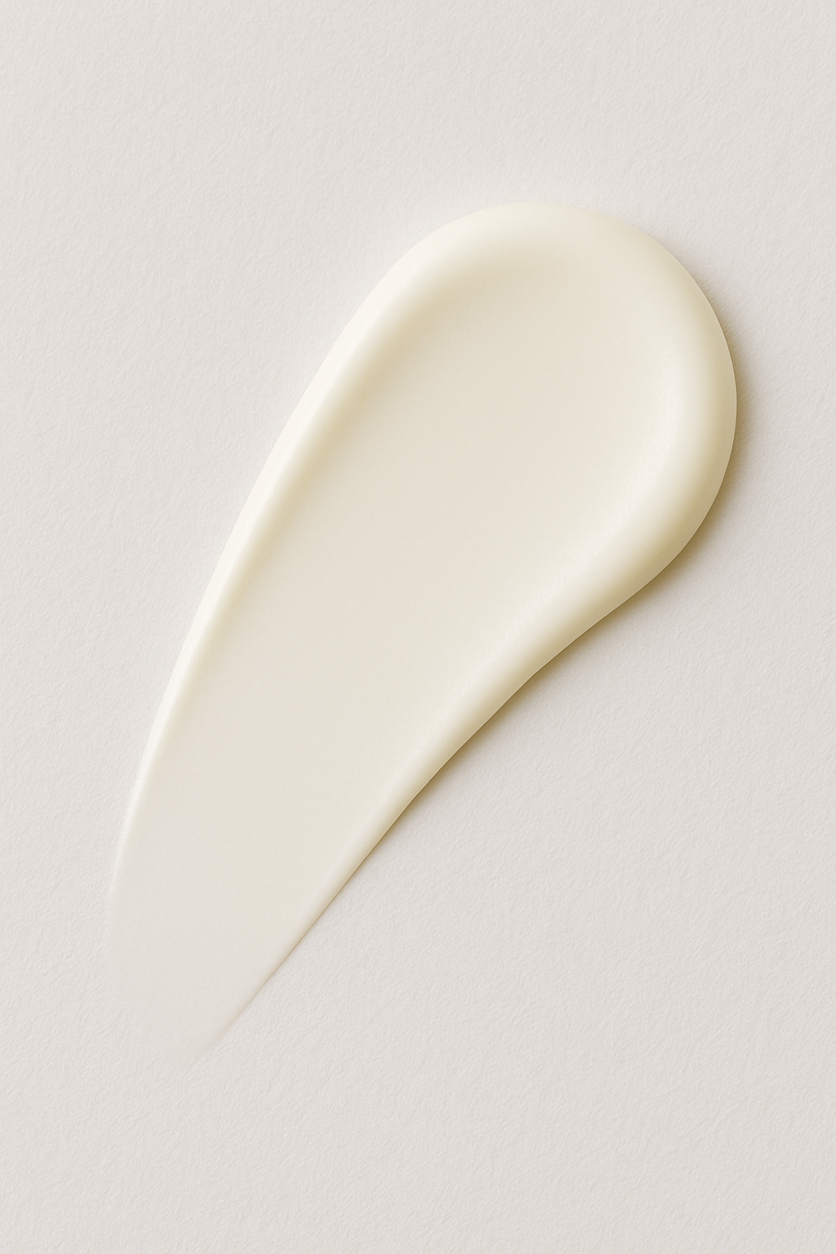
LIPEX® SheaSolve™ in suncare
Get inspired with our formulations
SunSafe Mineral Stick SPF 50 ref: AAK-22-002
Free from chemical filters, this reef-friendly stick is formulated with titanium dioxide and zinc oxide to act as an effective physical protective barrier against UV light.
Clear & Invisible Sunscreen Stick SPF 50 ref: AAK-23-012
A water- and sweat-resistant sunscreen with no white residue featuring Lipex PreAct, Lipex SheaSolve, Lipex SheaTris.
Urban Defense Daily Face Cream SPF 30 ref: AAK-17-312
This beautifully light day cream is easy to apply, it absorbs quickly without any ghosting or residue and harnesses the bioactivity of lipids found naturally in shea and canola to safeguard the skin and help maintain a radiant, youthful complexion.
The Co-Development Company

Slide 13
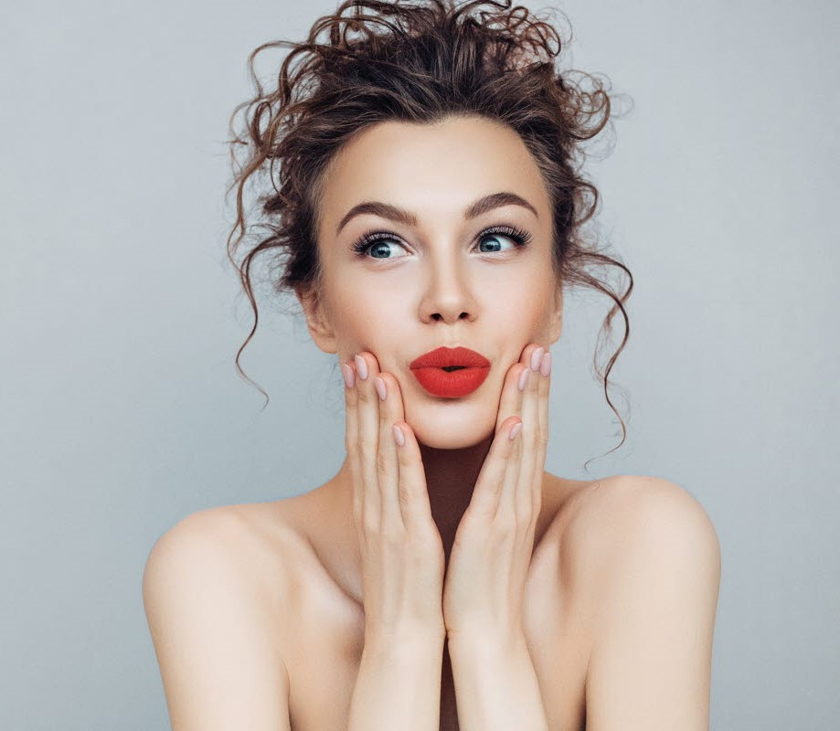
LIPEX® SheaSolve™ in Make-up
The Co-Development Company

Slide 14
LIPEX® SheaSolve in make-up
Shows the best dispersing capabilities and processing conditions
LIPEX® SheaSolve generates low viscosity dispersions with the two tested colorants.
A lower viscosity of the final dispersion indicates:
  - Better wettability of the pigments → lower agglomeration → more homogeneous color
  - Reduces the need for additional wetting/dispersing agents
  - Easiness to work in the lab and scale up
  - Ability to disperse a higher amount of pigment at a workable viscosity, ensuring a higher color payoff.
Roller mill dispersion conditions: Regular setting with “2” on rear and “1” on the front; pass batch through roller mill 3 times. Viscosity measurements were done with an Anton Paar Rheometer MCR301 under 10 S-1 shear rate and 20˚C temperature

Slide 15
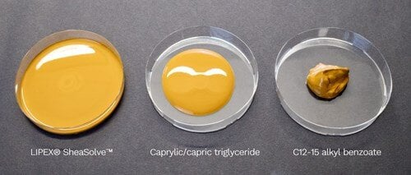
LIPEX® SheaSolve in make-up
Able to produce the lowest viscosity dispersions
The above image shows 20% yellow iron oxide dispersions in different emollients. The Lipex SheaSolve dispersion is flowable, the caprylic/capric triglyceride dispersion is thicker but also flowable, and the C12-15 alkyl benzoate dispersion doesn’t flow.
See it for yourself with this video :
Achieving low viscosity FINAL - YouTube

Slide 16
LIPEX® SheaSolve in make-up
Able to produce the lowest viscosity dispersions at different levels and with different coating
INCI: Titanium Dioxide, Silica, Cetyl Phosphate
LIPEX® SheaSolve consistently delivers low viscosity dispersions, regardless of the concentration or the type of titanium dioxide used.
By being a versatile emollient across pigments and pigment types, processing conditions and concentrations, LIPEX® SheaSolve releases pressure and time on the product development process.

Slide 17
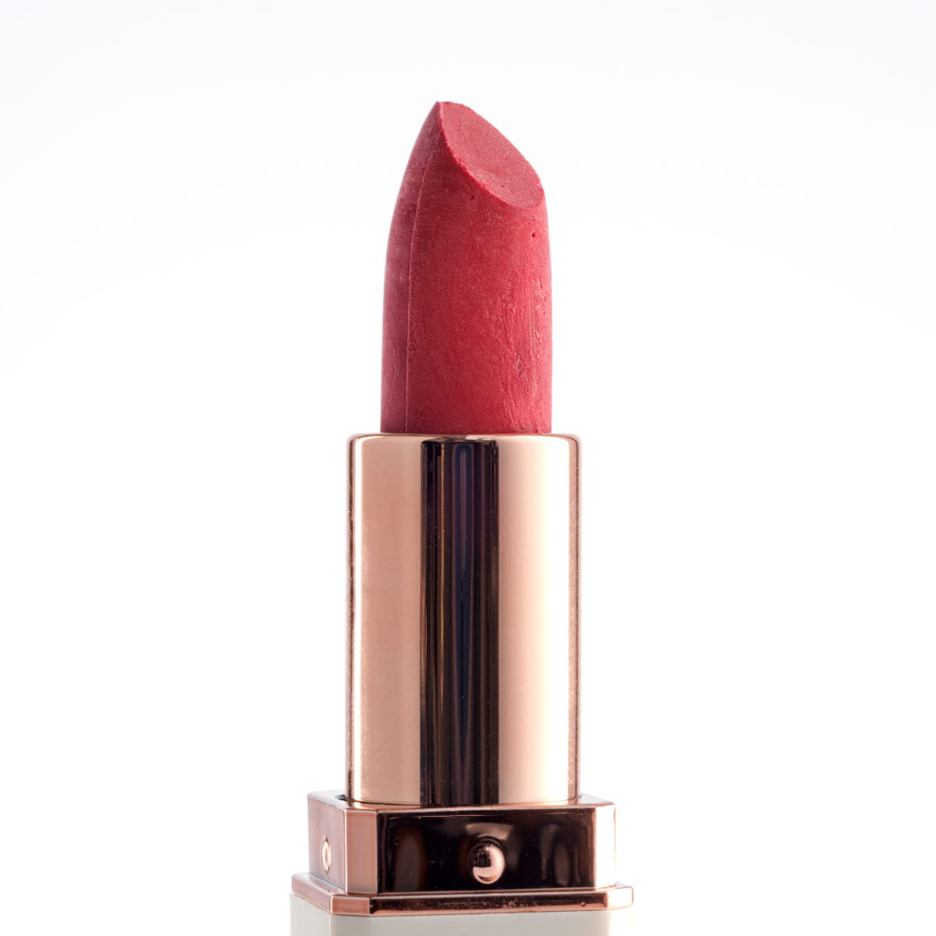
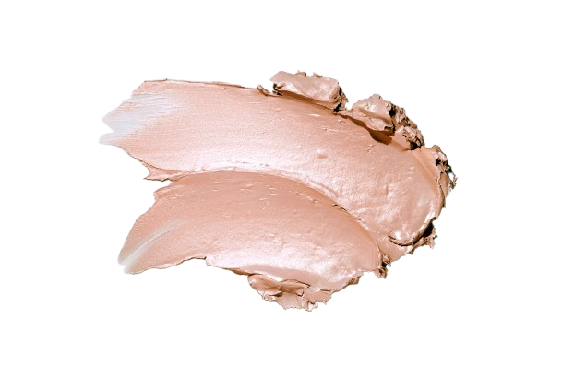
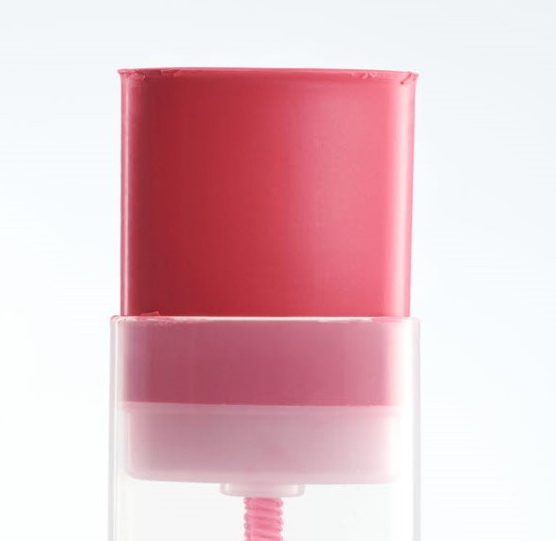
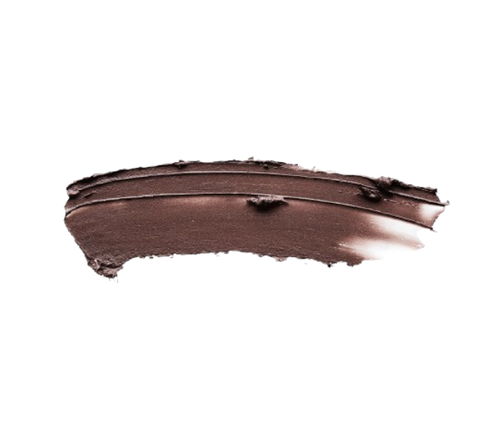
LIPEX® SheaSolve™ in Make-up
Get inspired with our formulations
La Vie en Rose Creamy Matte Lipstick ref: AAK-23-007
This long-wear lipstick, delivers a perfect matt finish offers supreme comfort, thanks to the nourishing benefits of a duo of highly moisturizing shea-based emollients.
Luminous Star Highlighter Stick ref: AAK-24-008
Say hello to the glow with this easy to apply highlighter stick. Simply swipe to illuminate cheekbones, décolletage, or anywhere you want gleaming, gorgeous skin.
Natural Origin Index: 97%*
Candy Floss Blush Stick ref: AAK-24-001
A cream-to-matte tinted balm in a handy stick format, the formulation delivers a fresh flush of buildable color in a single swipe, blends seamlessly with the skin for beautiful, radiant results.
Bronze Bombshell Creamy Eyeshadow ref: AAK-24-007
Dial up the drama in an instant with this luxurious creamy bronze eyeshadow, crafted with sustainably sourced plant-based ingredients to deliver a uniquely hydrating, lightweight texture.
Natural Origin Index: 99%*
*according to ISO 16128

Slide 18
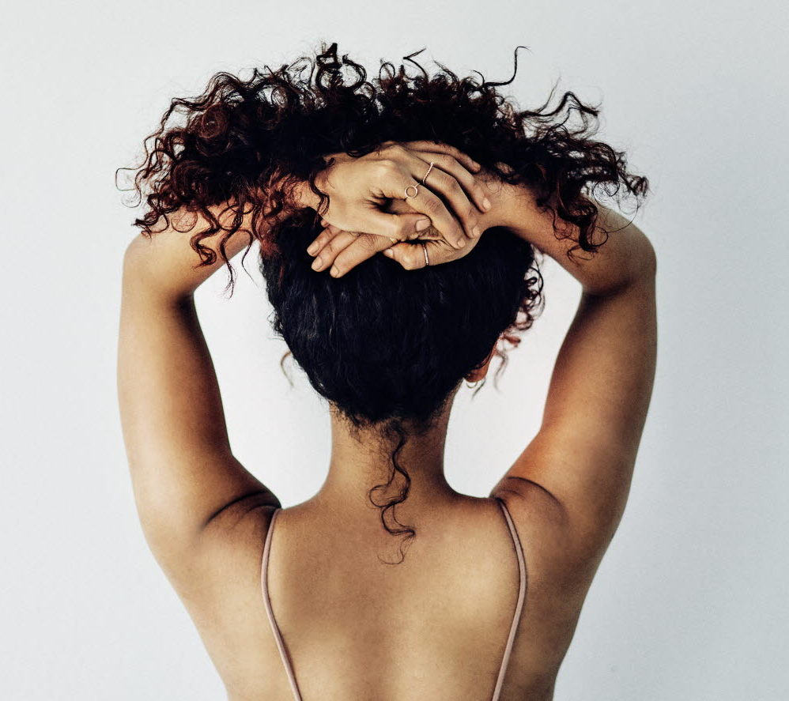
LIPEX® SheaSolve™ in Hair care
The Co-Development Company

Slide 19
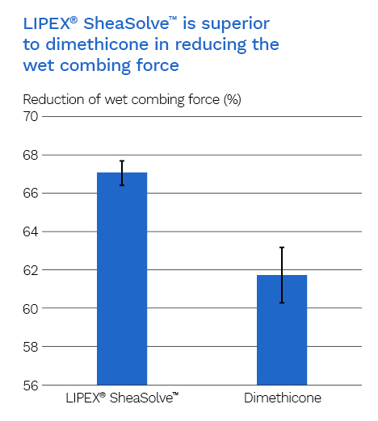
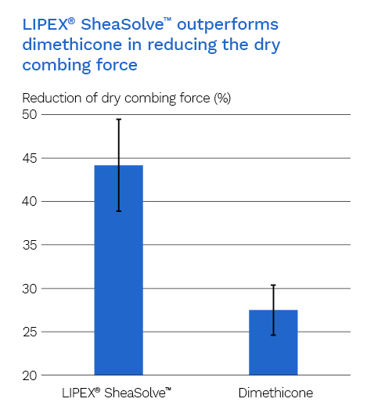
LIPEX® SheaSolve™ in Hair Care
LIPEX® SheaSolve™ outperforms dimethicone to improve combability on both wet and dry hair, reducing the probability of hair breakage.
In Vivo Testing show that it delivers similar sensory, spreadability and rinsability benefits as dimethicone throughout the whole washing process. And there was no significant difference in performance between the two.
Low viscosity and good spreadability ensure uniform coating of hair fibers with a thin, weightless, moisturizing film to improve silkiness, shine and combability, making LIPEX® SheaSolve™ a good alternative to linear, low molecular weight silicones in hair care application.

Slide 20
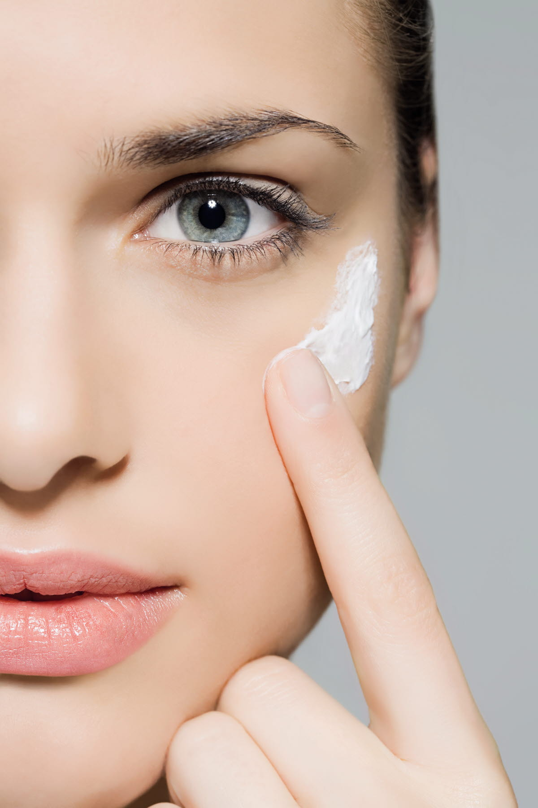
Achieve natural, lightweight and silicon-like textures in skin care & hair care with
Lipex® SheaLuxe TRTM

Slide 21


LIPEX® SheaLuxe TR™
INCI: Ethyl Oleate, Ethyl Stearate
Ester from natural Ethanol & Shea Butter
Very similar sensory profile to low viscosity dimethicones, and commonly used plant-based esters and alkanes
Skincare: light texture, non-greasy finish, moisturizing, anti-soapy
Haircare: anti-frizz, shine and combing ease.
Functionality
Fully Traceable to the Kolo Nafaso program
Sustainably – sourced shea
Empowering women shea collectors.
Climate-Compensated
Readily Biodegradable- (OECD 301F)
Eco-designed, 100% Renewable sources.
Sustainability
Legal compliance

Slide 22
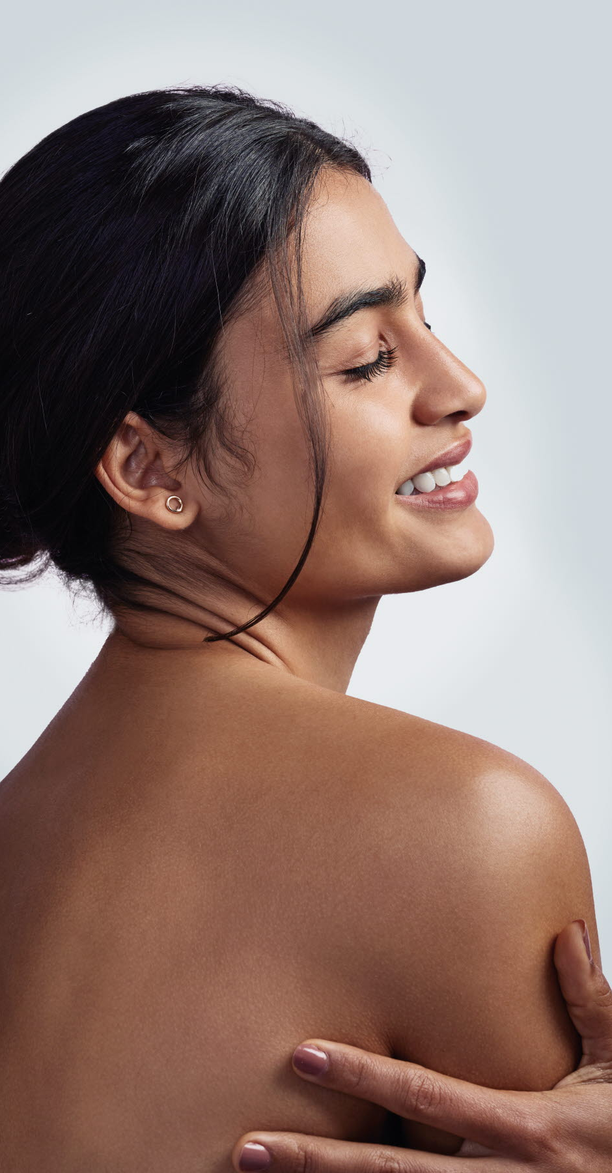
The benefits of LIPEX® SheaLuxe TR™
Lightweight textures
Evanescent after feel
Moisturization
Anti-soaping effect
Anti-frizz
Shine
Combing ease
Lightweight, non greasy textures
SKINCARE
HAIRCARE
LIPEX® SheaSolve
Alternative to non-volatile silicones, alkanes & other plant-based esters
Colorless
Low viscosity
Miscible with commonly used oils & butters
Compatible and miscible with ethanol
Derived from 100% natural and renewable sources
100% traceable
Climate compensated
Biodegradable
Sustainability
Formulation flexibility

Slide 23
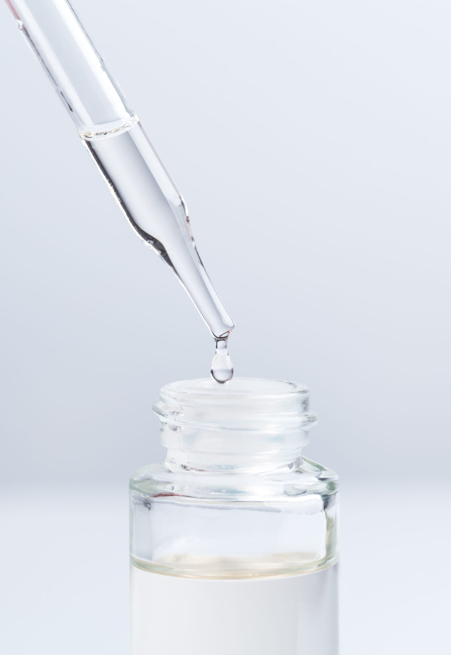
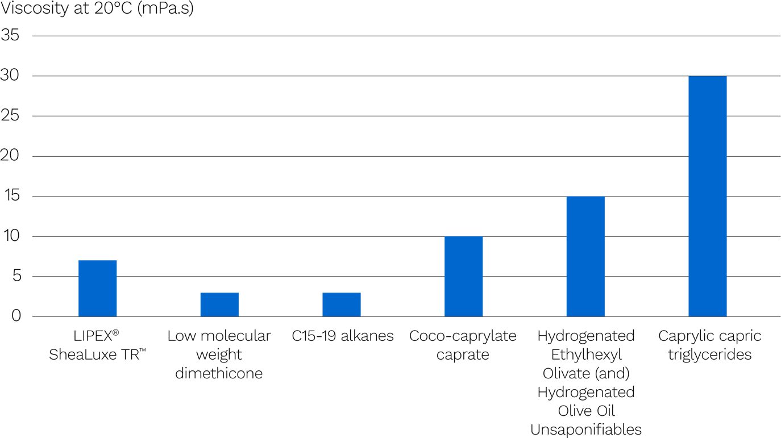
LIPEX® SheaLuxe TR™
Processed to have a low viscosity
The viscosity of LIPEX® SheaLuxe TR™ is at a similar level to coco-caprylate caprate, low molecular weight dimethicone or alkanes.
The low viscosity makes it easy to spread and gives it a light feel during application.

Slide 24
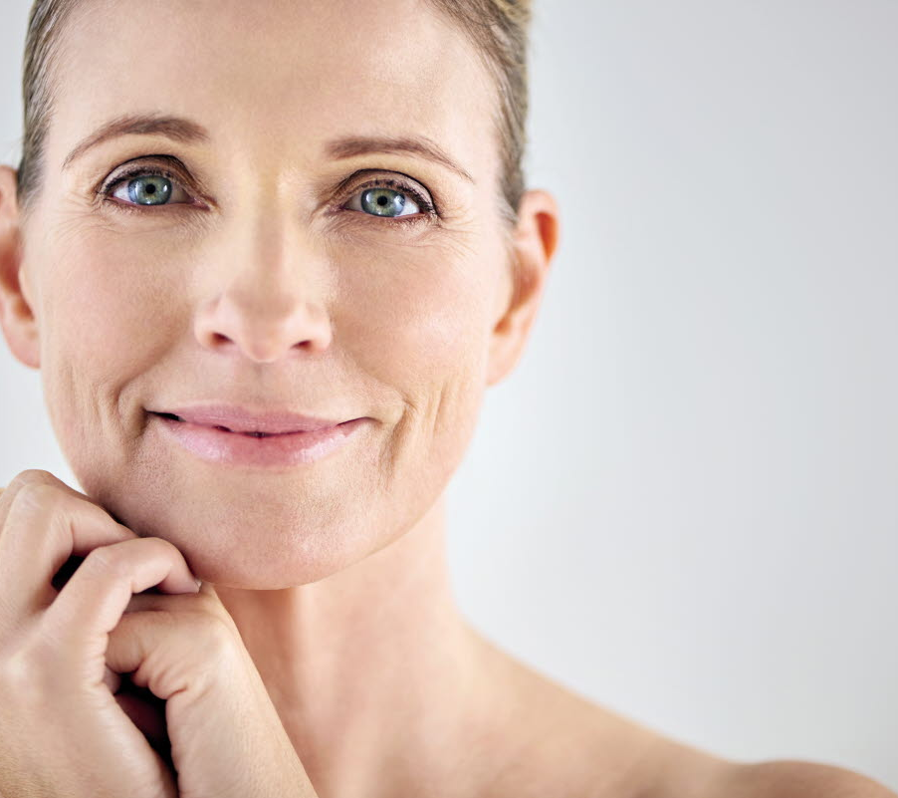
LIPEX® SheaLuxe TR™ in Skin care
The Co-Development Company

Slide 25
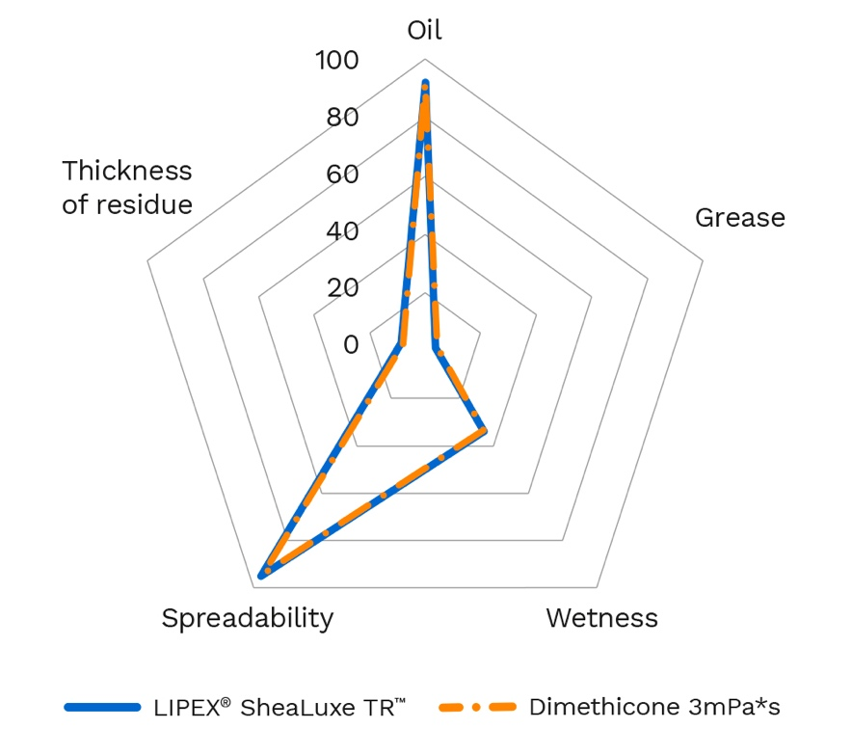
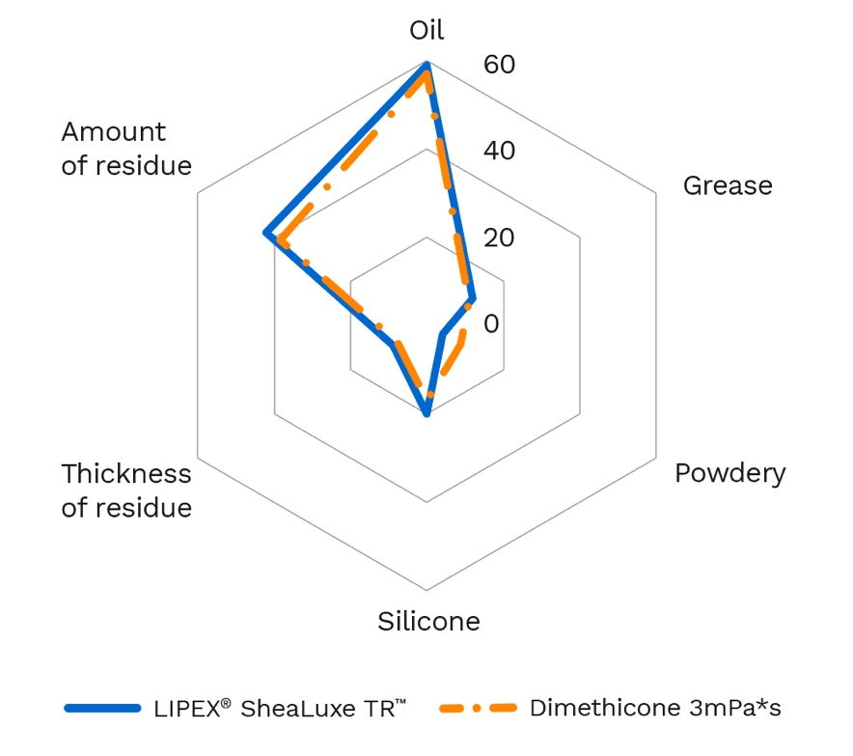
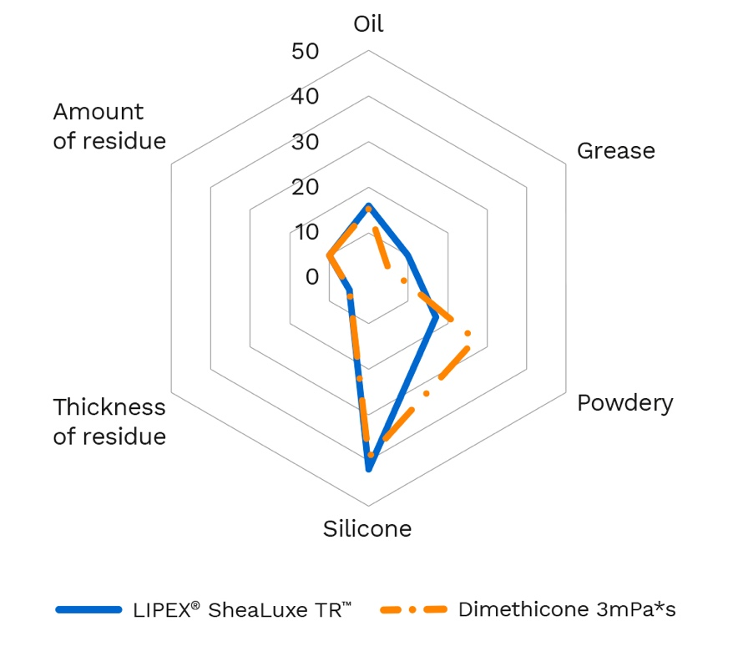
LIPEX® SheaLuxe TR™ in skincare
Similar sensory profile in application and after-feel to a low viscosity dimethicone
Initial rub
In immediate after-feel
In after-feel after 20 min
Light, oil-like, dry, non greasy,
high spreadable
Leave a light, oil-like, non greasy feel
with some silky character
Leave a light, non greasy, silky residue
Emollients are evaluated by the Sensory Spectrum Skinfeel Descriptive Panel for sensory attributes. 10 panelists, trained in Spectrum Skinfeel Descriptive Analysis method and oriented to the study protocol. Randomized Complete Block Design.

Slide 26
LIPEX® SheaLuxe TR ™ in skincare
Show a similar short and long-term effect in reducing TEWL than dimethicone
Lipex© SheaLuxe TR™ and dimethicone are equal in their ability to reduce the TEWL 3,6 and 24 hours after application.
It can be concluded that Lipex SheaLuxe TR and dimethicone have
  Moderate short-term effect on the skin barrier
  A slight residual effect after 24 hours, indicating a long-lasting effect.
Emulsions with 20% emollients were prepared according to a standard recipe that has been used previously in moisturization studies with dimethicone 50 cSt or Lipex© SheaLuxe TR™. The emulsions were evaluated for their barrier enhancing properties using TEWL measurements. All tests were made by ITA-Test, Warsaw, Poland, in September-October 2023.
A test panel of 13 persons aged 25-43 were used in the test to provide a total of 20 testpoints for each emulsion.
Background value of TEWL was measured before the application and 4 mg/cm² of the emulsion was applied. TEWL measurements were made at 3, 6 and 24 hours after the application, using a TEWAMETER 625 (Courage & Khazaka GmbH).

Slide 27

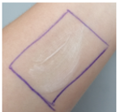
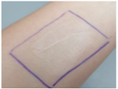
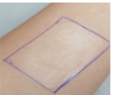
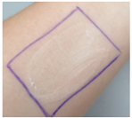
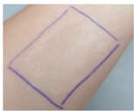
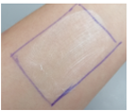
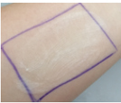
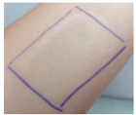
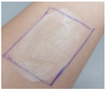
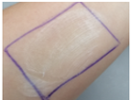
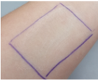
LIPEX® SheaLuxe TR reduces the soaping effect
Solution 1: focusing on liquid emollients
 | Negative control(*) | LIPEX® Shealuxe TRTM | Dimethicone 5mPa.s
2 rubs
5 rubs
10 rubs
20 rubs
The negative control shows significant soaping on skin.
Dimethicone, as expected, has a very significant antisoaping effect.
LIPEX® SheaLuxe TR has a visible antisoaping effect, even if inferior to dimethicone.
Emulsion including 10% of the tested ingredient.
0,045g of emulsion were applied in a surface of 5cm*3cm on the forearm and rubbed 2, 5, 10 and 20 times. A picture was taken at the different moments in time and evaluated for soaping.
(*) Almond oil used as a negative control

Slide 28
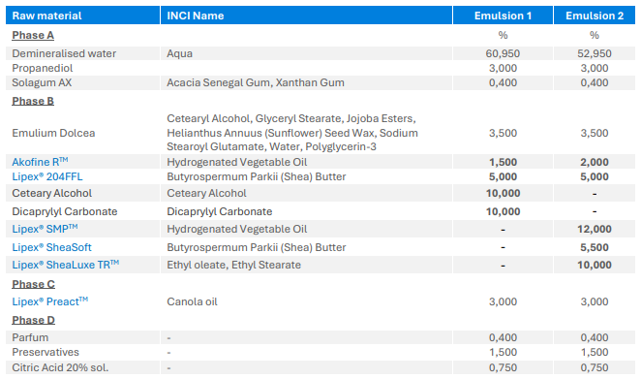
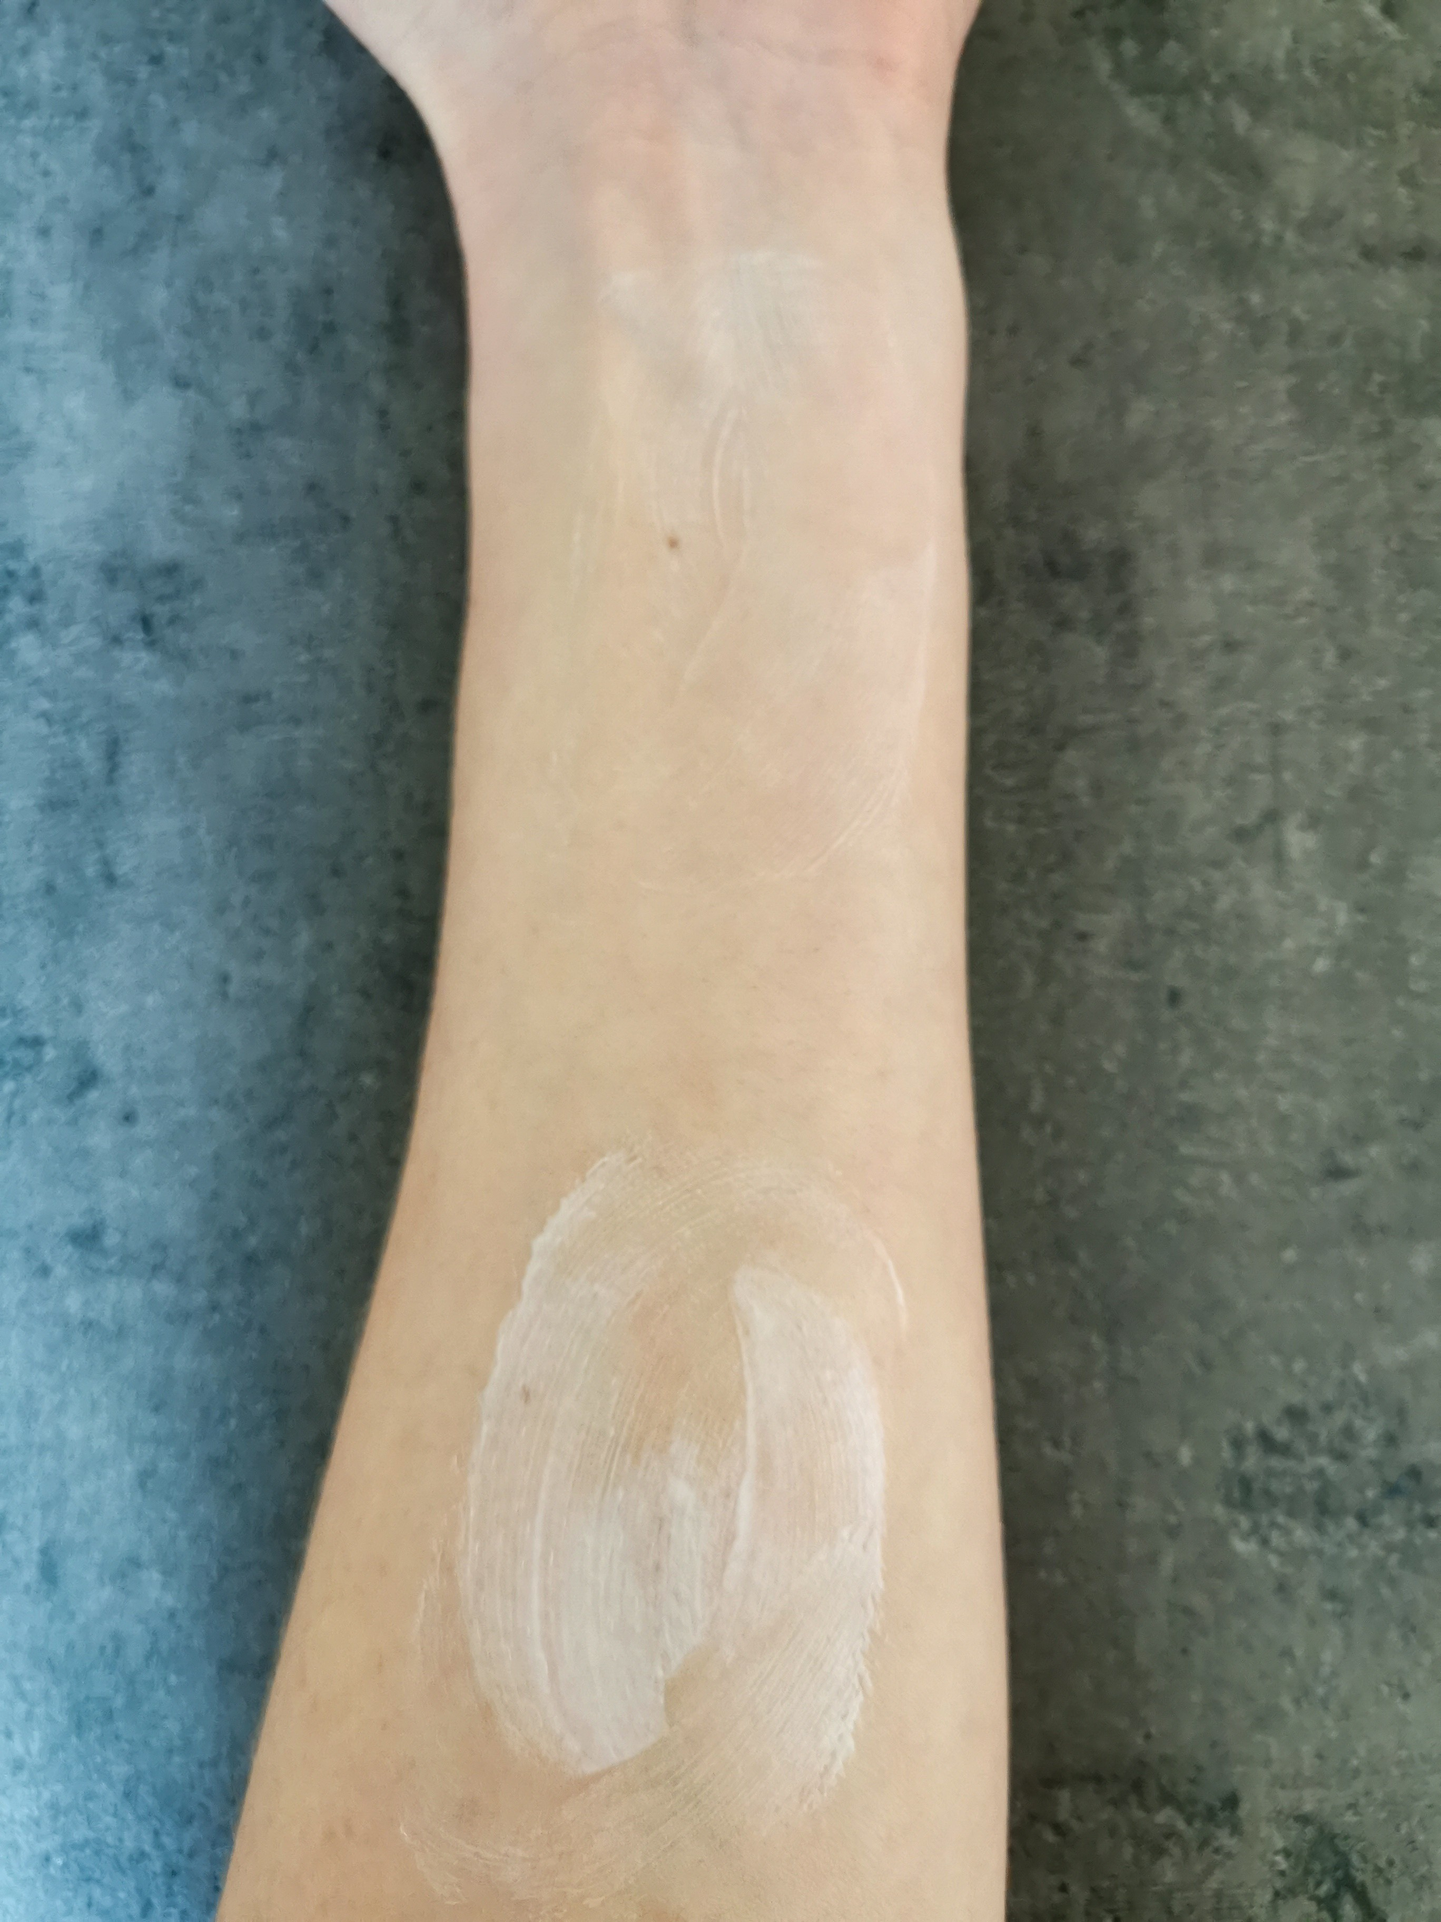
Solution 2: combining ingredients to fight soapiness
Emulsion 1
Emulsion 2
0,05g of each formulation were applied on the forearm and picture was taken after 5 rubs.
The Co-Development Company

Slide 29
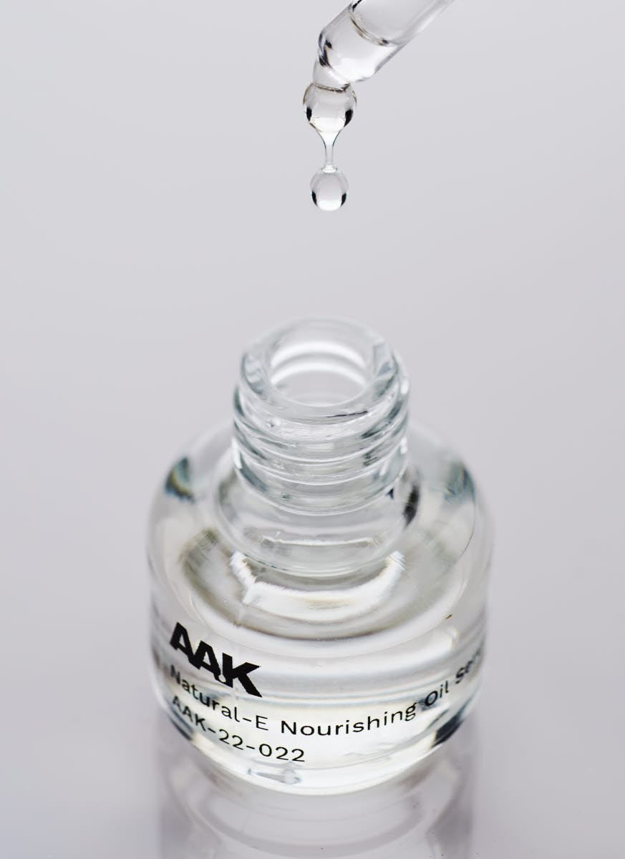
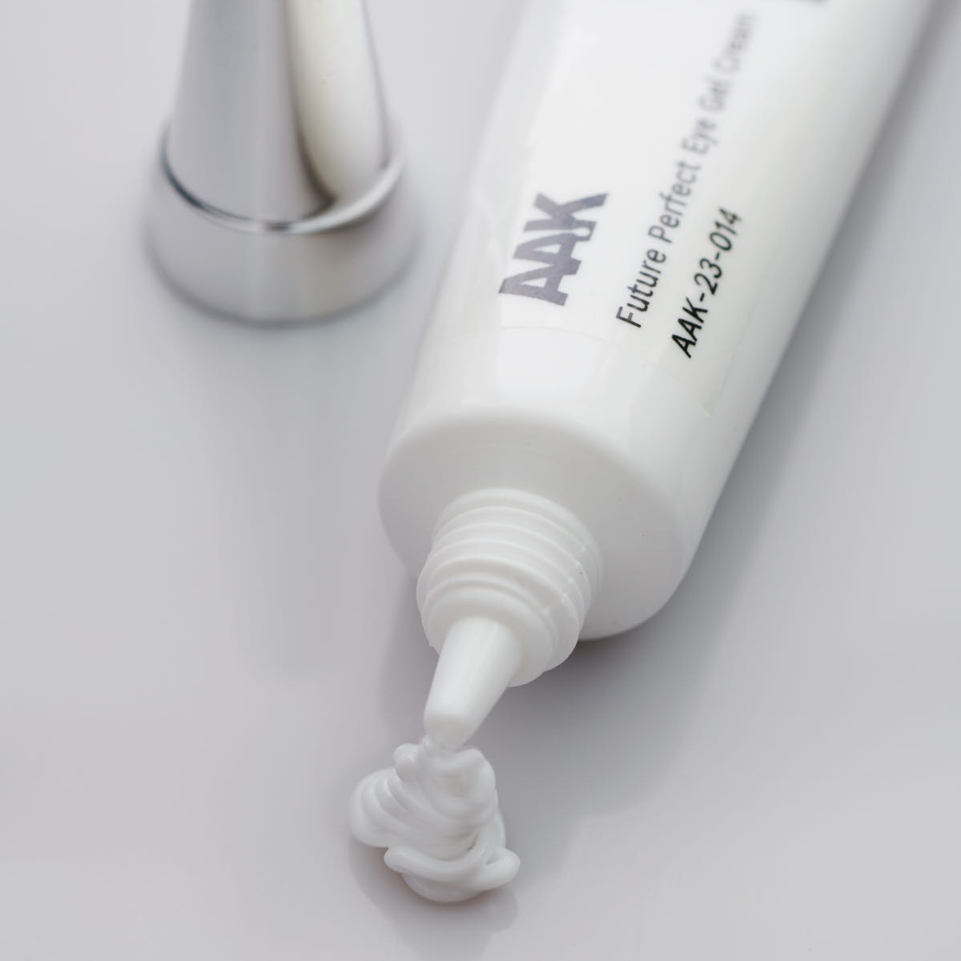
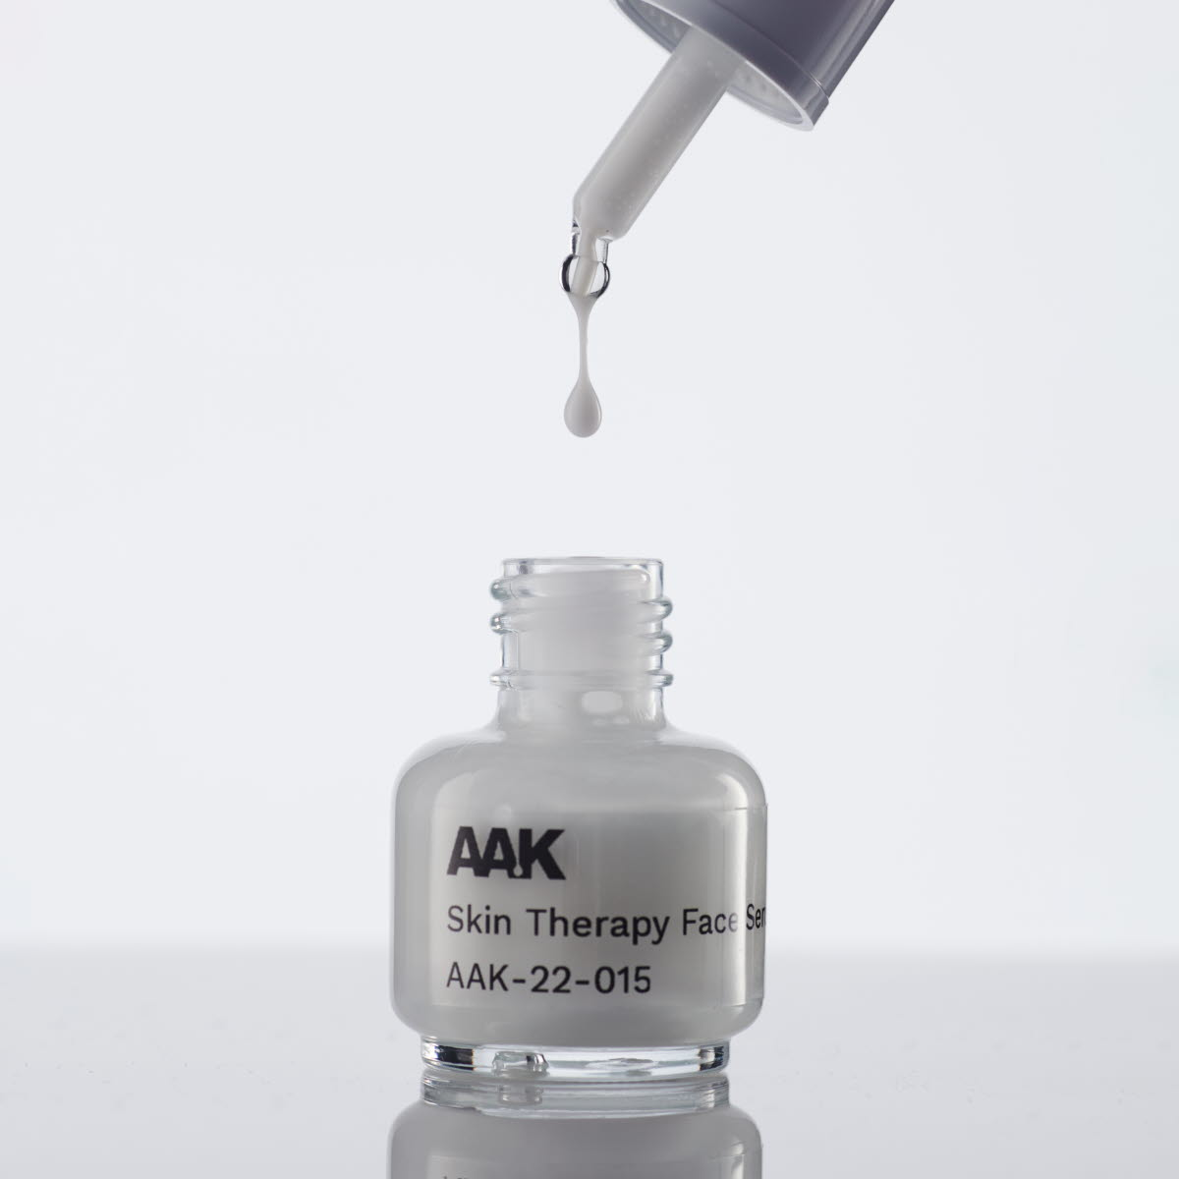
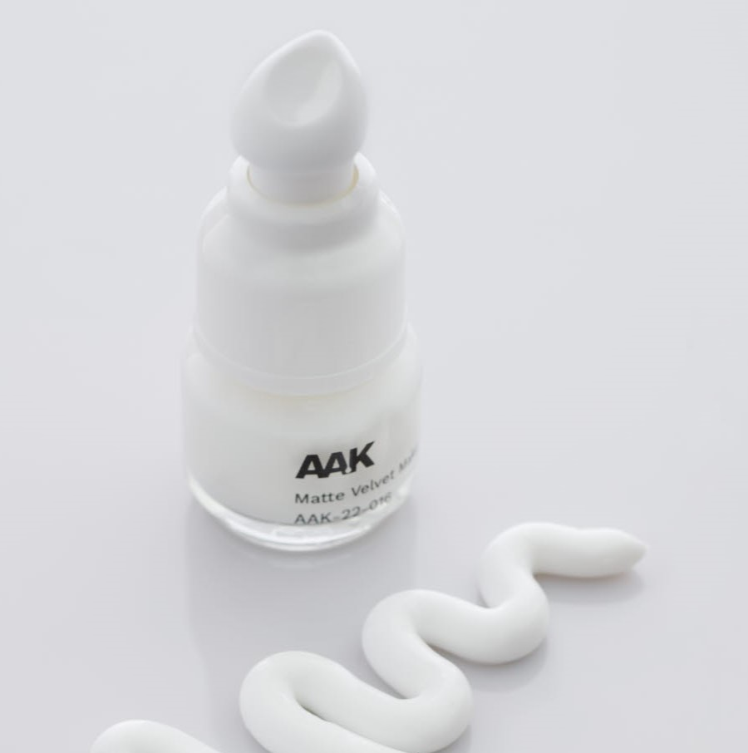
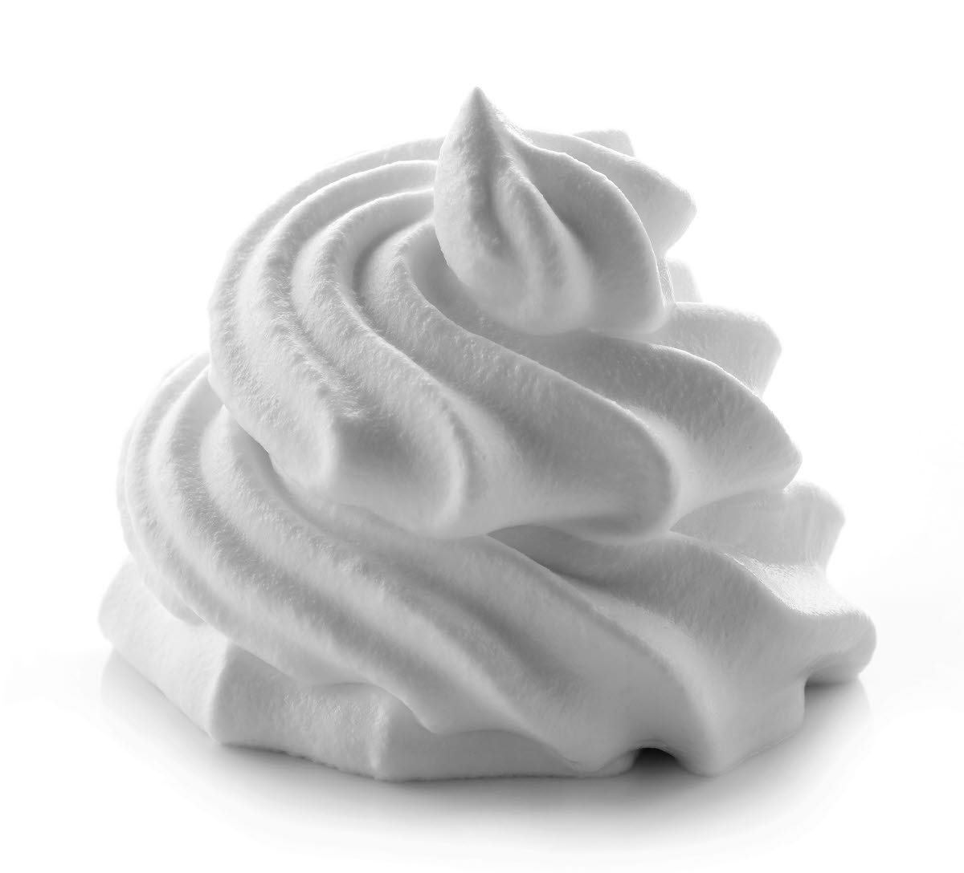
LIPEX® SheaLuxe TR in skin care
Get inspired with our formulations
Natural-E Nourishing Oil Serum ref: AAK-22-022
Based on shea, canola, and gold of pleasure extracts, this fast-absorbing, silky-light serum harnesses the power of plant-based tocopherols, a natural source of Vitamin E, and omega fatty acids to protect, replenish, and nourish. Vegan-friendly, biodegradable, and simply delightful. Natural Origin Index : 100%*
Future Perfect Eye Gel Cream ref: AAK-23-014
This gel cream is a water-in-oil formulation with an amazingly light skin feel. It uses traceable, climate-compensated shea ingredients to nourish, replenish, and protect dry, dehydrated skin. Enhanced with a concentrate of phytosterol esters derived from eco-friendly canola.
Natural Origin Index : 99%*
Skin Therapy Face Serum ref: AAK-23-015
This oil-in-water formulation is one pot cold-processed at room temperature, using a climate-neutral, shea-based ester to deliver the light, silicone-like skin feel. Natural sources of tocopherols, phytosterols, and omega fatty acids protect and strengthen the skin barrier. Natural Origin Index : 99%*
Matte Velvet Makeup Primer ref: AAK-22-016
This silicone-free, ultra-light complexion-perfector reduces shine and minimizes the appearance of pores, creating a smooth, flawless, and long-lasting base for makeup. Natural Origin Index : 99%*
Meringue Surprise Body Whip ref: AAK-24-002
This lustrous meringue-inspired body cream delivers an unexpected sensory twist. It appears rich and firm on first impression but melts to a deliciously airy light texture on application. It leaves no tacky residue, and the skin instantly looks and feels soothed, smooth, and evenly toned.
*according to ISO 16128

Slide 30
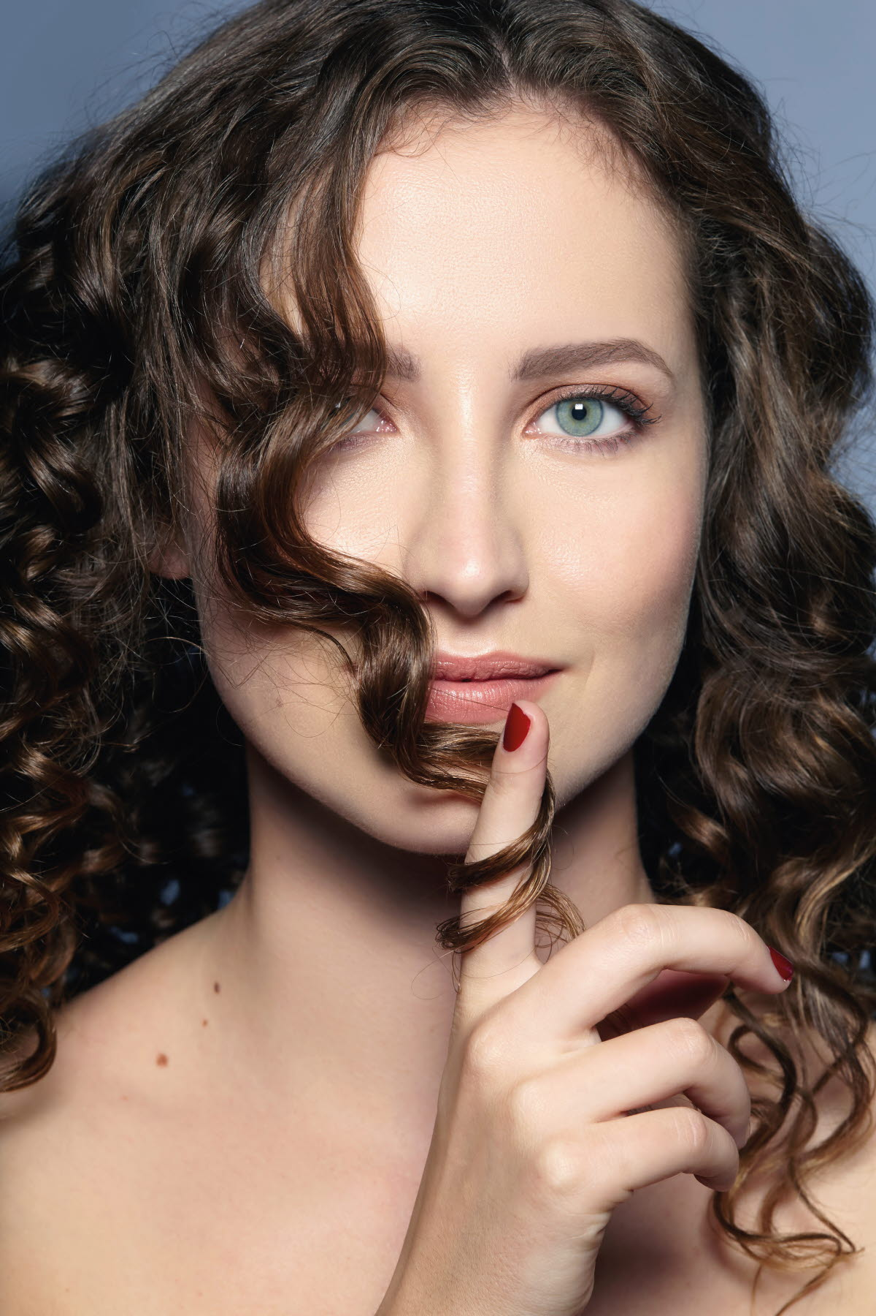
LIPEX® SheaLuxe TR™ in Hair care
The Co-Development Company

Slide 31











LIPEX® SheaLuxe TR in haircare
A superior short- and long-term anti-frizzing effect to dimethicone
Untreated
T= 0
1
2
3
1
2
3
T= 1
T= 8
LIPEX® SheaLuxe TR has a superior effect reducing frizz at application,
and excels at preventing frizz over time in a humid environment
Procedure:
- Clean a Caucasian hair tress of 7g with 1mL Sodium laureth sulfate solution pH 5,5.
- Dry the hair tress with a hairdryer for 5 minutes
- Comb and straighten the hair 4 times & measure – this is the reference (untreated t=0)
- Apply 4 drops (0.1g) of the pure raw material on a clean hair tress of 7g & measure (treated t=0)
- Place the hair tress in a humid chamber at 25°C with 85% humidity.
- Measure at different times (1,2,4 & 8 hours)
Control (Untreated)
Dimethicone 5mPa.s
LIPEX SheaLuxe TR
1
2
3
1
2
3

Slide 32









LIPEX® SheaLuxe TR in haircare – in formulation
Has a superior short- and long-term anti-frizzing effect to dimethicone
Untreated
T=0
1
2
3
1
2
3
T=1
T=8
LIPEX® SheaLuxe TR has a superior effect reducing frizz at application,
and is the only one able to prevent frizz generation over time in a humid environment
Procedure:
See previous slide
Formulation:
Hair oil inspired from a market product: 20% Canola oil, 20% Argania spinosa kernel (Argan) oil, 10% Ricinus Communis (Castor) Seed oil, 10% Prunus Armeniaca (Apricot) Kernel Oil, 25% Test Product
1
2
3
1
2
3
Control (vegetable oil)
Dimethicone 5mPa.s
LIPEX SheaLuxe TR

Slide 33
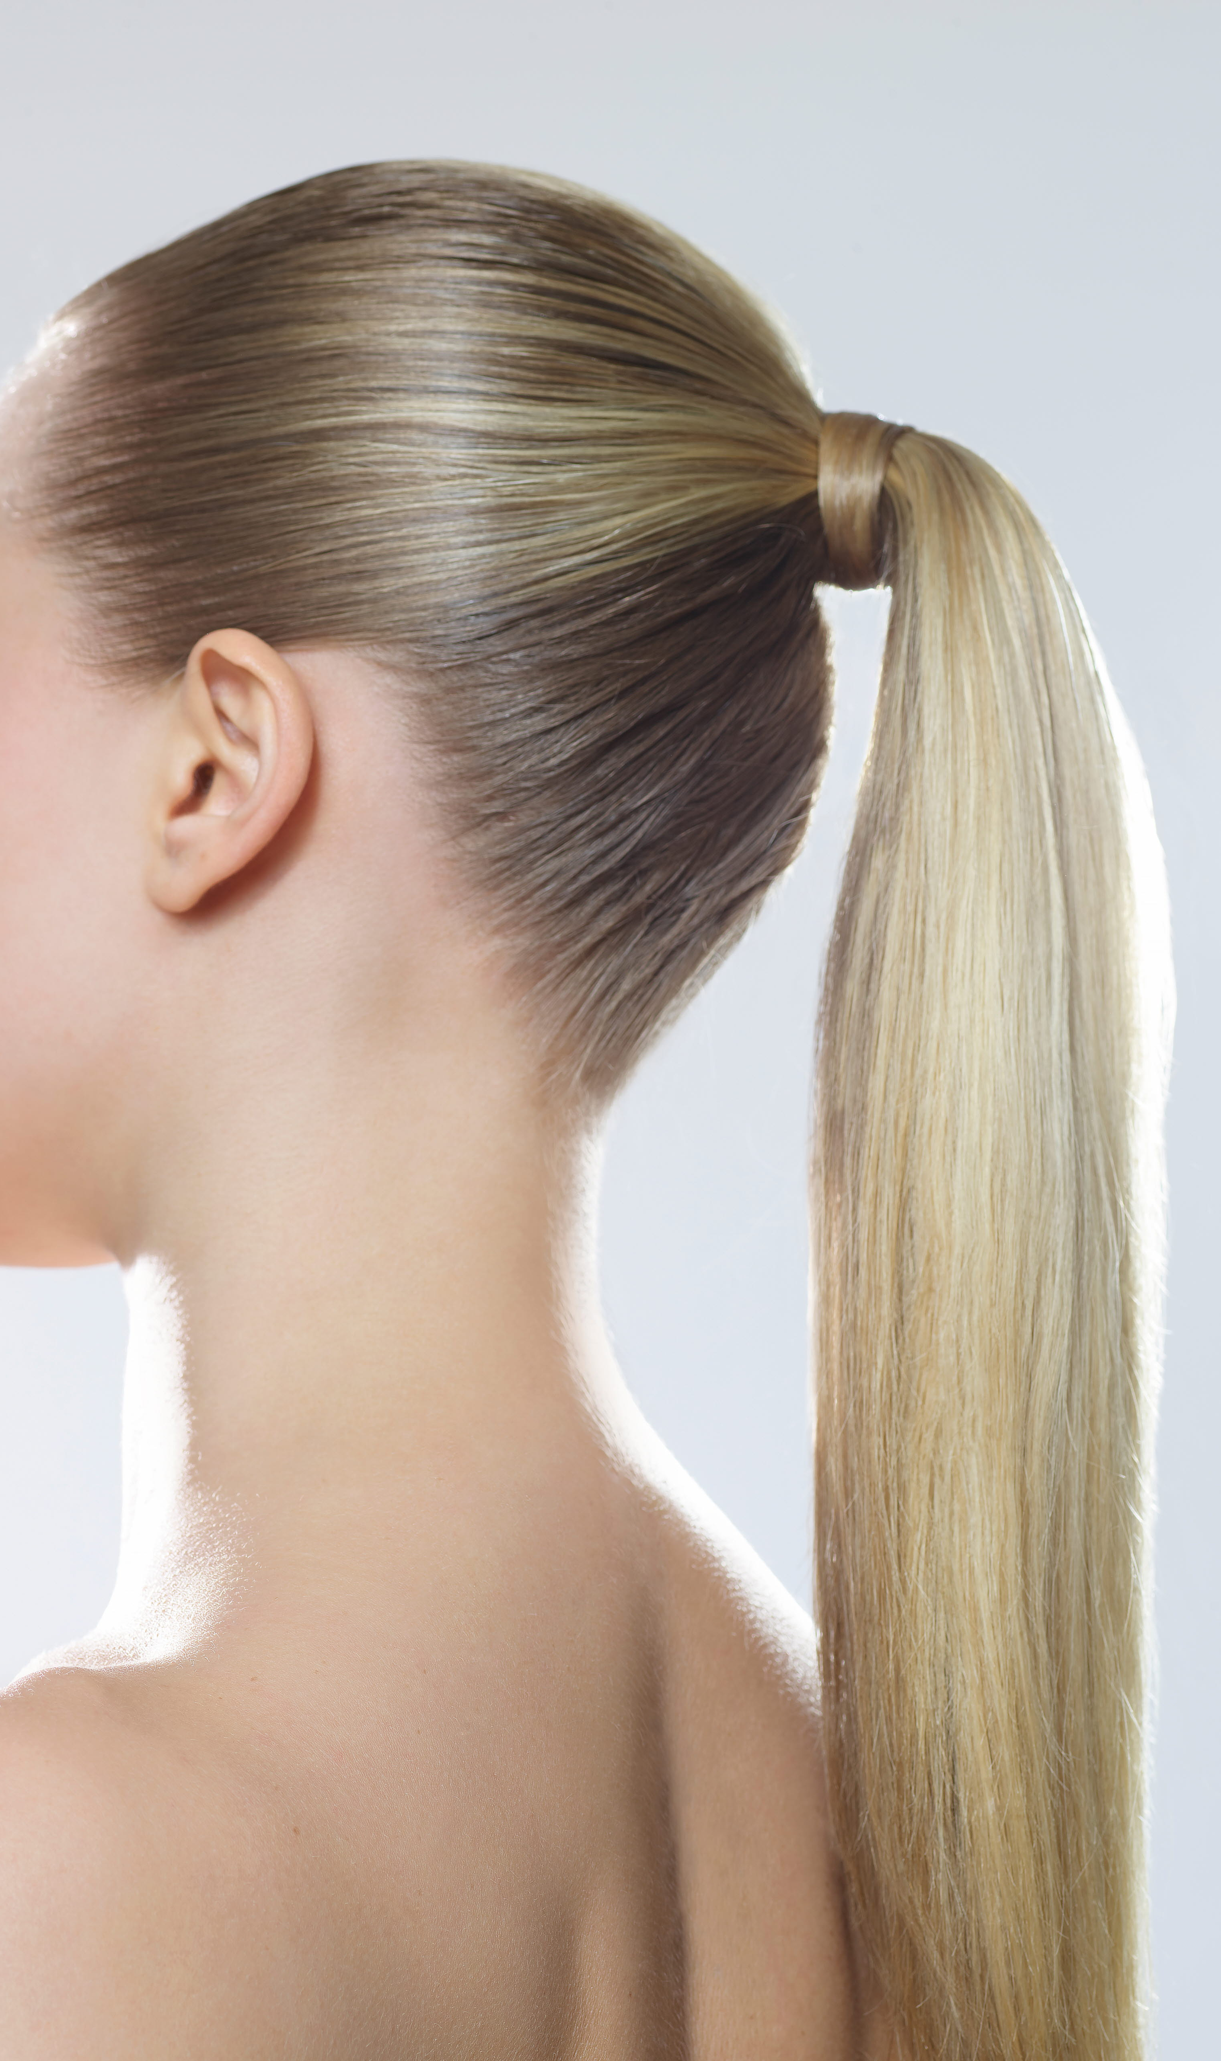
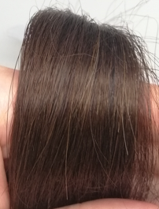
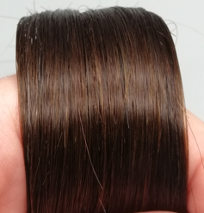




LIPEX® SheaLuxe TR in haircare
A higher long-term shine effect than dimethicone
 | Untreated | Dimethicone 5mPa.s | LIPEX® SheaLuxe TR
T=0
T=8
Right after application dimethicone delivers the highest shine – but both solutions deliver a good level of shine
After 8 hours in a humid chamber LIPEX SheaLuxe TR delivers higher shine
Procedure:
Clean a Caucasian hair tress of 7g with 1mL sodium laureth sulfate Solution pH 5,5.
Dry the hair tress with a hairdryer for 5 minutes
Comb and Straighten the hair 4 times
Take a photo of the clean hair tress = T0 under a light box with fixed “natural” light
Apply 4 drops (0.1g) of hair serum or of the pure raw material on a clean hair tress of 7g
Place the hair tress for 8 hours in a humid chamber at 25°C with 85% humidity
Take a photo of the hair tress after 8 hours under a light box with fixed “natural” light
The shine property of the materials is assessed by looking at the photos.

Slide 34






LIPEX® SheaLuxe TR in haircare – in formulation
Has a higher long-term shine effect than dimethicone
 | Untreated | Vegetable oil | Dimethicone 5mPa.s | LIPEX® SheaLuxe TR
T=0
T=8
All solutions deliver high shine, with dimethicone being slightly superior
After 8 hours in a humid chamber, LIPEX SheaLuxe TR delivers the highest shine
Formulation:
20% Canola oil, 20% Argania spinosa kernel (Argan) oil, 10% Ricinus Communis (Castor) Seed oil, 10% Prunus Armeniaca (Apricot) Kernel Oil, 25% Test Product
Procedure:
See previous slide

Slide 35

LIPEX® SheaLuxe TR in haircare
Show a similar combing ease effect than dimethicone
Combing ease as pure raw materials:
On wet combing, LIPEX® Shealuxe TR and Dimethicone 5mPa.s reduce the force equally
On dry combing LIPEX® Shealuxe TR reduces the force needed slightly more than Dimethicone 5mPa.s

Slide 36




LIPEX® SheaLuxe™ in haircare
Get inspired with our formulations
Hydra’luxe Elixir ref: AAK-24-016
A powerful blend of natural ingredients makes this multitasking hair oil a must-have for shine, softness, and protection. Whether you’re dealing with dryness, dullness, frizz, or all three, just a few drops on damp or dry hair are all it takes to restore your locks to their glossy best. Natural Origin Index : 100%*
MallowWhip Curl Mousse ref: AAK-25-001
Define and nourish very dry waves and curls with this rich yet airy styling mousse. Perfect for air-drying or diffusing, it tames parched, frizzy locks, enhancing the natural curl pattern without weighing down the hair or leaving a greasy, sticky or crunchy residue. Natural Origin Index : 98%*
Sleek and Wet Glam Gelée AAK-24-023
Get on board with this season’s sultry wet-look hair trend. Whether you’re slicked-back bob or a sleek high ponytail, this silicone-free styling gel delivers fabulous, soft-to-the-touch, long-lasting tamed locks.
Natural Origin Index : 99%*
DermaBalance Scalp Lotion AAK-25-002
Expertly crafted with a trio of plant-based emollients, designed to nourish and soothe, it helps alleviate dryness and irritation while providing a protective barrier against environmental stressors.
Natural Origin Index : 99%*
*according to ISO 16128
The Co-Development Company

Slide 37
Everything we do is about
Making Better HappenTM
Thank you!

